Slide 1

Real Autobots and Decepticons
Programming a Self-Reconfiguring Robot
Notes:
Introduce ourselves 30 seconds

Slide 2



Notes:
Hook: Talk about self-reconfiguring robots 30-45 seconds

Slide 3
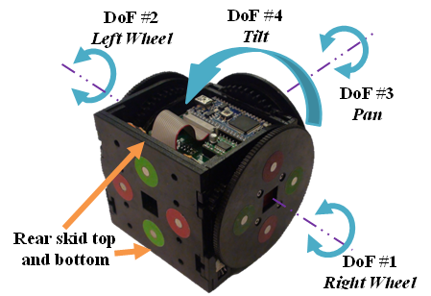
Notes:
Describe what the ECE department has been doing 1 minute

Slide 4
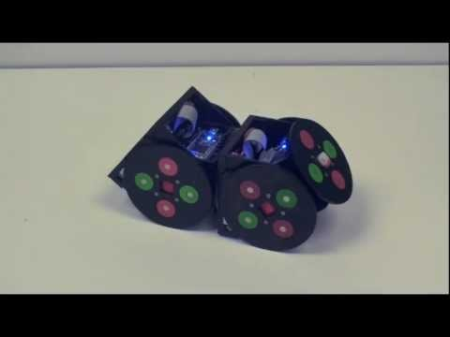
Notes:
Show video about how they work 90 seconds
Is there a better video?

Slide 5

Goal
Unaided assembly of modules into a predetermined formation from completely random starting points
Notes:
Explain the ultimate goal of our research 60 seconds

Slide 6
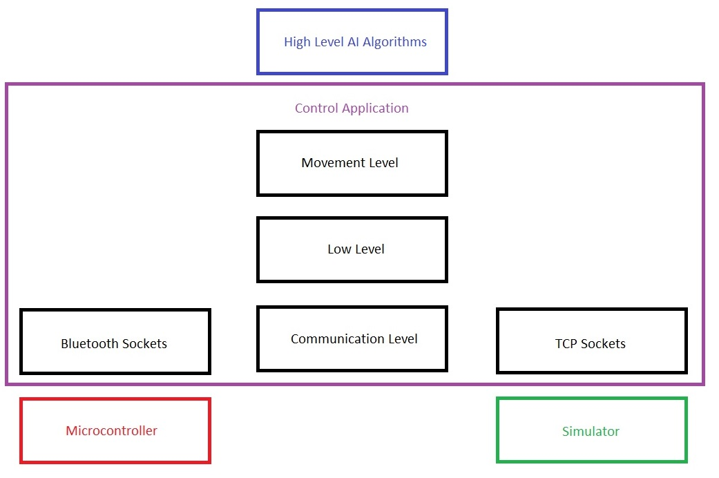
Requirements
Virtual Model in Webots Simulator
Python Control Application
Python Algorithms for 2-3 Formations
Notes:
Discuss the 3 main requirements and why we need them. 1 min each

Slide 7

Risks
Roadblocks
Unfinished Bots
Python Bluetooth support
Alternate Solution
4-6 formations in simulator only
Create adaptor in alternate language
Notes:
Explain the two major unknowns 1 min each
1. If the ECE guys don’t give us a working bot then we will try to do more formations in the simulator only
2. If python’s BLE support is insufficient then we will have to make an adaptor in an alternate laguage

Slide 8

Q & A
Notes:
Answer Questions

